Slide 1
Regression
Andrew Beatty
Andrew.Beatty@gmit.ie
Programming for Data Analysis

Slide 2
This Lecture
What is Correlation?
What is regression?
Visualisation with seaborn
sklearn

Slide 3
In code
import numpy as np
x = np.arange(10, 20)
# array([10, 11, 12, 13, 14, 15, 16, 17, 18, 19])
y = np.array([2, 1, 4, 5, 8, 12, 18, 25, 96, 48])
# array([ 2, 1, 4, 5, 8, 12, 18, 25, 96, 48])
r = np.corrcoef(x, y)
#array([[1. , 0.75864029],
# [0.75864029, 1. ]])

Slide 4
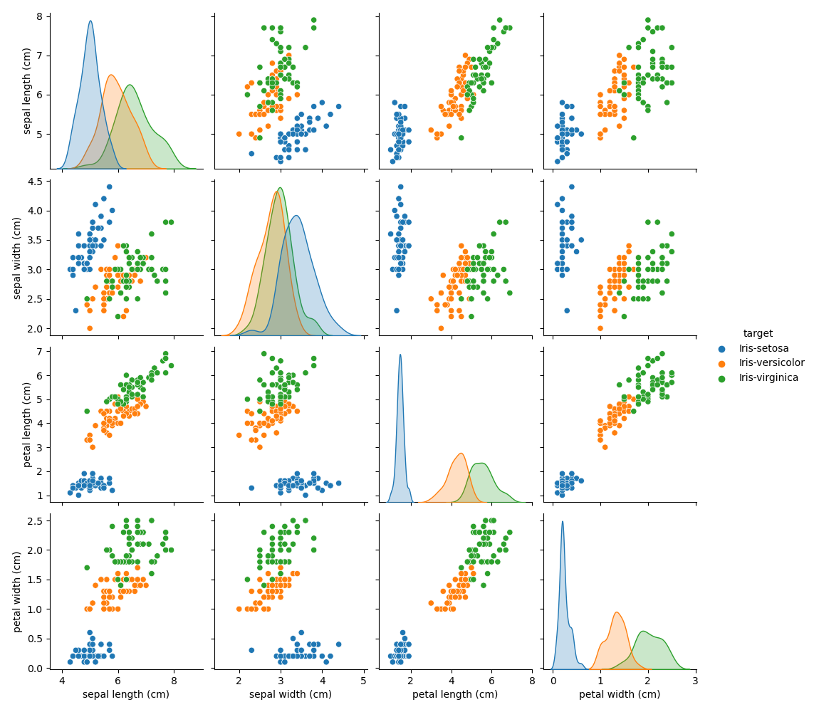
Iris

Slide 5
import pandas as pd
dataurl=“XXX"
irisdf = pd.read_csv(dataurl)
print (irisdf.corr())
sepal length (cm) sepal width (cm) petal length (cm) petal width (cm)
sepal length (cm) 1.000000 -0.109369 0.871754 0.817954
sepal width (cm) -0.109369 1.000000 -0.420516 -0.356544
petal length (cm) 0.871754 -0.420516 1.000000 0.962757
petal width (cm) 0.817954 -0.356544 0.962757 1.000000

Slide 6
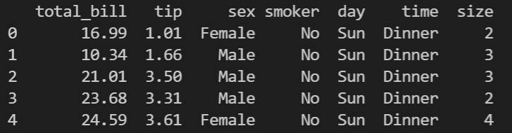
What is regression
Find a pattern in data (between 2 or more variables)
Seaborn has a built in dataset called tips

Slide 7
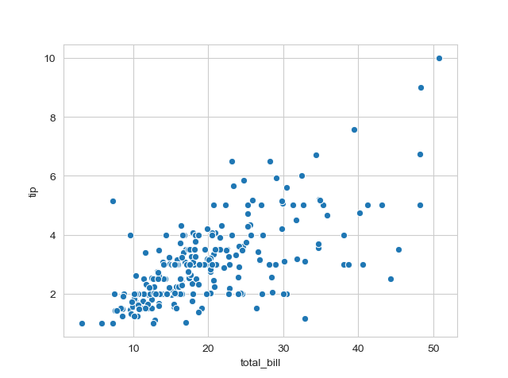
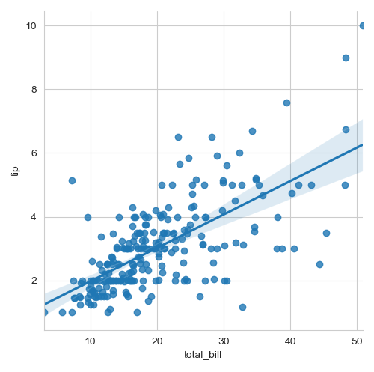
What is regression

Slide 8
The code
# import the library
import seaborn as sns
import matplotlib.pyplot as plt
# load the dataset
dataset = sns.load_dataset('tips')
# the first five entries of the dataset
print(dataset.head())
sns.set_style('whitegrid')
#sns.scatterplot(x='total_bill',y='tip',data=dataset)
sns.lmplot(x='total_bill', y='tip', order=1, data=dataset)
plt.show()

Slide 9
What is this doing
Confidence interval
Finds the line such that the sum distance between each datapoint and the lines square distance is minimised.
In this case a straight line. (order=1)
Note in this case it is not through the origin.
residual
Least squares regression line

Slide 10
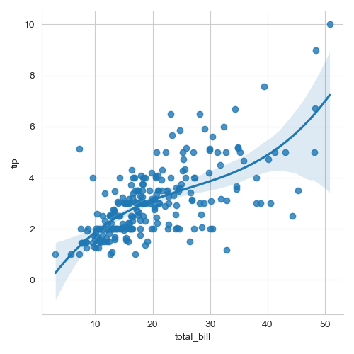
Same data with different order
Order 1
Order 3

Slide 11

vocabulary
Independent variables, inputs, or predictors in this total bill
dependent variables, outputs, or responses in this case tips
Order of the polynomial, the order of the line that are trying to fit (eg curve is x squared)
Residual: difference between a point and the least square line
Correlation : measure of the strength of association
coefficient of determination, denoted as 𝑅², tells you which amount of variation in 𝑦 can be explained by the dependence on 𝐱 using the particular regression model.
Outlier: a point with a large residual
Y-intercept (intercept) : is the point the line crosses the y axis

Slide 12
seaborn
regplot()
lmplot() (is regplot and the scatter plot)
Residplot() : plots the residuals, this is very useful is seeing if the linear regression is a good fit.
Jointplot()

Slide 13
Other tutorials
I have put links to the tutorial in the references section

Slide 14
Stretch

